Slide 1
A PRESENTATION ON AGGRESSION DETECTION

Slide 2
problem definition
To design an android application to detect the aggression level, with importance to patients suffering from Alzheimer’s and dementia after acquiring the specific characteristics of the patient. Different parameters such as Heart rate, Blood Pressure, Motion Detection and most importantly Speech Recognition technology mainly focused to solve the problem of patient on patient violence
AGGRESSION:
Aggression can be defined as a state of mind in which an individual is subjected to uncontrollable anger or antipathy resulting in a hostile behavior causing harm to them and/or the people around them by the means of a physical or verbal attack, triggered by anxiety, depression, unrest, un-friendly environment sometimes un-controllable emotions whose occurrence may be sudden and due to apparent reasons.

Slide 3
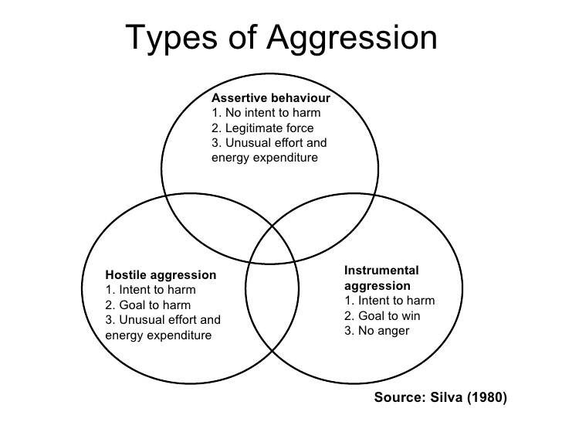
Understanding aggression

Slide 4
Understanding aggression
AGGRESSION BROADLY CLASSIFIED AS:
Instrumental Aggression: They are noticed in people who are determined to achieve their goals at any cost, but can lead, sometimes to harm’s way.
Hostile Aggression: They are intended to harm other people, cases have been noticed in which people have attacked their own family members.
Assertive Aggression: They are the most commonly noticed in couples , friends in most of cases not harmful.
According to Journal of American Medical Association, the casualties caused , especially patient on patient and patient on care taker violence are mainly due to hostile aggression.

Slide 5
Understanding aggression
The application of this project has major influence from Human Activity Recognition.
Human activity recognition (HAR) - highly dynamic and challenging research topic.
Makes use of sensory devices to observe the activities or changes in behavior of a person.
Sensors used include sensory devices which are embedded in clothing or wearable devices dynamically monitoring the patient’s physical or mental activities.
Cameras enforced to keep an eye on the patient’s activities - audio-video based solutions
Instant assistance provided by the care giver.

Slide 6
Aggression leading to Alzheimer’s
Analysis to determine importance of identifying what triggers a person that is suffering from Alzheimer’s or dementia so that he/she can be assisted immediately.
Trigger - sets off an emotional episode—in this case, an aggressive one.
Family members know what triggers the patient towards aggressive behavior, they must make sure they let the hospital faculty know about the patient’s medical history. This will enable the medical staff to assist the patient in a better manner.
A comprehensive plan for avoiding these triggers, aggressive or disturbing behavior can be avoided up to certain extent is designed and implemented.

Slide 7
Aggression leading to dementia
Direct observation and measurement of behavioral changes implemented on patients suffering from dementia to understand the causes.
Trained observers use various methods to record occurrences of precisely defined target behaviors and other events - triggers calculated designated observational periods.
This data is examined - based on the signals recorded by various means.
Research has been conducted to test the accuracy of these data – affirmative results noted.
According to the results - major causes – hypertension, blood pressure, constantly subjected to mental stress.

Slide 8
Aggression leading to dementia
Hypertension linked with dementia but - development is unclear.
Changes in blood pressure - done for a particular age interval - usually in elderly patients between the ages 60-80.
Patients suffering from dementia between the ages of 79-85 often experience higher blood pressure than the rest. The systolic blood pressure is higher – diagnosed – at 140mm hg for systolic blood pressure and 90mm hg range – for diastolic blood pressure.
Inappropriate vocalizations - common observations during the initial stages of aggression in a dementia patient.
Fluctuation in decibel levels stimulate the sensory devices that are used to record the data.
Decibel level : 20 - 30 → Person is normal . Decibel level : 40 and above → Person is in a angry or unfriendly mode.

Slide 9
Parameters to detect aggression
The parameters under consideration are :
Blood Pressure – People under aggression - develop higher blood pressure – easily detectable by sensor – developed based on Omron’s blood pressure monitor.
Motion Detection – Repetitive irregular linear, horizontal , gyroscopic hand movements – detected by the accelerometer portion of the android wear.
Heart beat – Most complex part in computation - has a lot of variations – detected under same constraints of blood pressure.
Speech recognition - People under aggression – tend to repeat words in a undefined pattern – detected by the microphone which is available with the android – for better quality control can be attached to patient’s dress.

Slide 10
APPROACH TO THE PROBLEM
Application of PHP, java, XML interfacing Data Layer APIs and display the final output on a Android platform.
Main Obstacle faced – To develop a accurate, non-intrusive, non-intimidating, user-friendly wear for patient’s suffering from Alzheimer’s and Dementia.
Patient’s age – main constraint – the wear should not be a add-on crisis to them.
Compatibility – Should be able to work under different environmental constraints.
User-friendly – Its application should be understandable to everyone, irrespective of the background.
Equipment Required: Wearable Android Watches, Accelerometers, Microphone, WLAN – Connectivity.

Slide 11
STAGES OF implementation
First Phase:
Monitoring and detecting the parameters using android wear having multiple sensors → sending the values to the database
Second Phase:
This is the processing part – contains both back end and front end , initially input is differentiated depending upon the input parameters – values compared with the pre-defined individual patient baseline parameters – each parameter is analyzed separately – entire phase is called Multi Sensor Data Fusion.
Here the service call is made to enter the values from wear to database.
Third Phase:
Output the data to the users – two types- one output is the continuous updating of values to the application, the other one – triggering output – generated during the verge of the aggressiveness to the care taker.
Service call made from data base to User Interface.

Slide 12
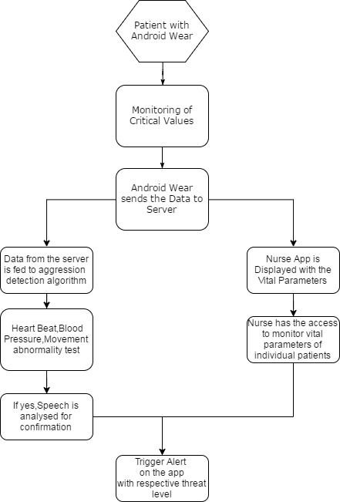
Data flow

Slide 13
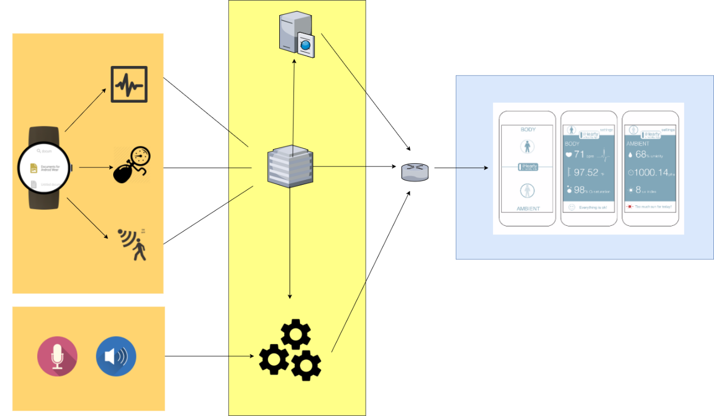
Control diagram

Slide 14
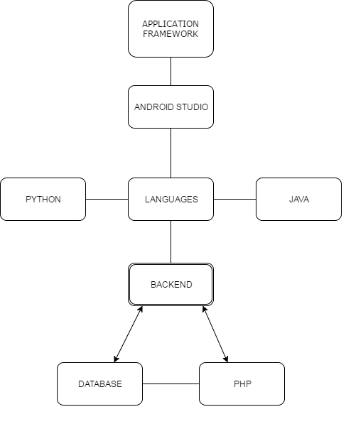
TECHNOLOGY STACK

Slide 15
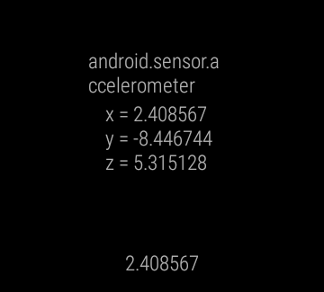
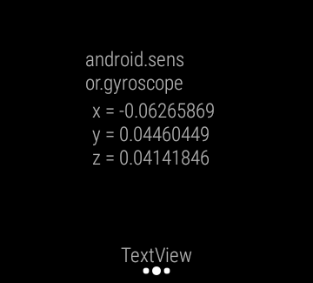
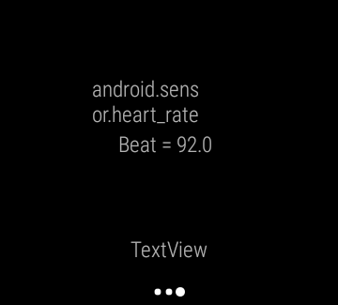
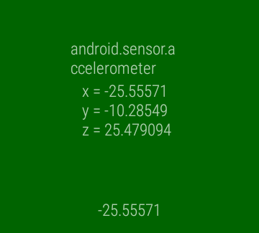
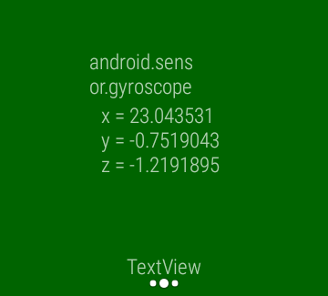
PROGRAMMED ACCELEROMETER READINGS

Slide 16
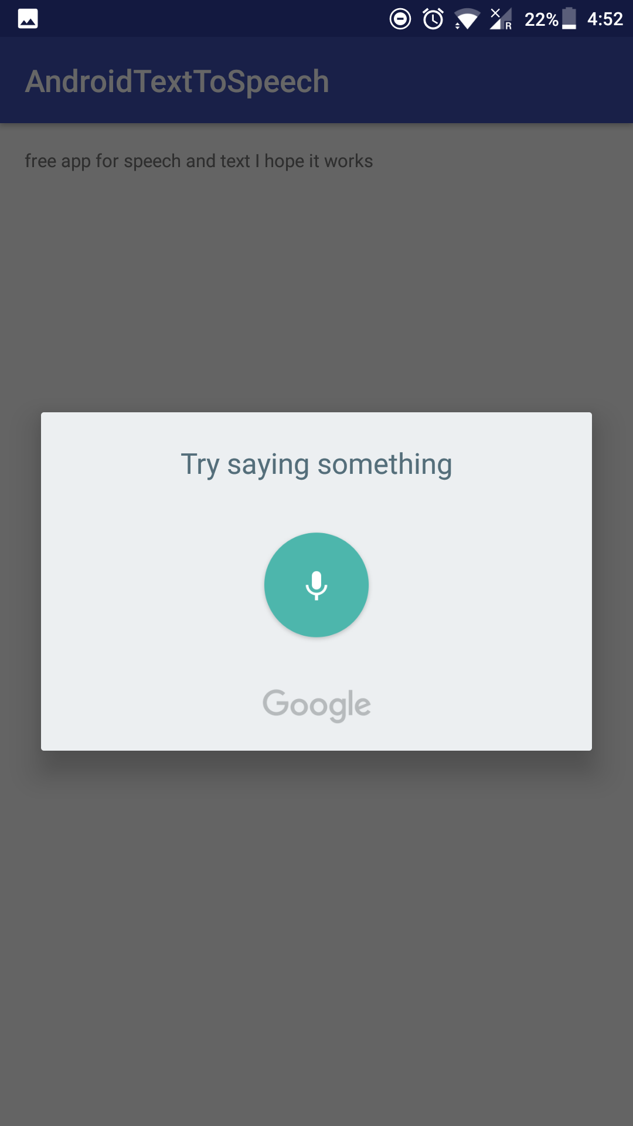
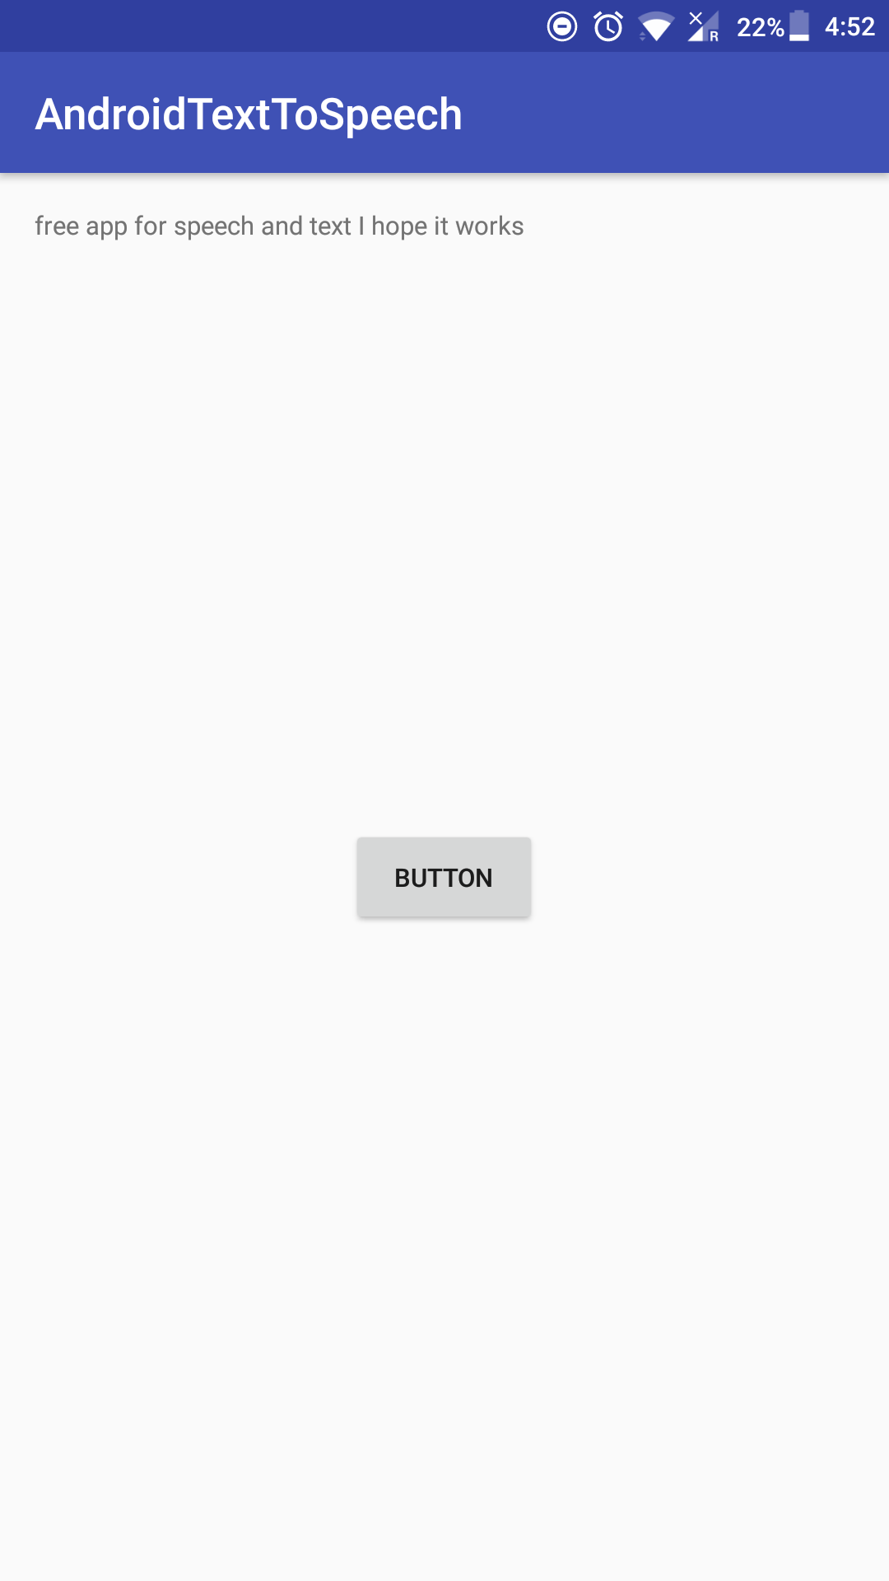
PROGRAMMED speech-to-text READINGS

Slide 17
Work till date
We have worked to retrieve the values such as Heart rate, Blood Pressure, Readings from accelerometer.
We were successful in passing the values from the android wear to the computer resource.
The next part of work will be :
Developing the UI.
Compare the baseline data with data read by the android wear.
Design the database.
Setting up the dynamic database for the patients.

Slide 18
CITATIONS
“When Aggression follows dementia”
A New York Times Report By Paula Span
“The Application of Aggressive Space Mapping Algorithm”
A combined report by Feng Cheng, Xi Deng, Jingping Song and Yunlin Yiu, Institute of Electromagnetics, Southwest Jiatong University, Chengdu, China.
“Calm hearts, Bad minds”
By David Kohn
“Neuropsychiatry of aggression”
A combined publication of Professor Scott.D Lane, Professor Kimberly. L Kjome and Professor F.Gerard Moeller
“Facial Action Coding System”
A publication by the Paul Ekman Group.
“Local Binary Patterns”
By Matti Pietikainen.

Slide 19
Thank you
PRESENTED BY:
Adithya Ramesh
Aishwarya Kiran
Chirag D.K
Surabhi N

